Slide 1



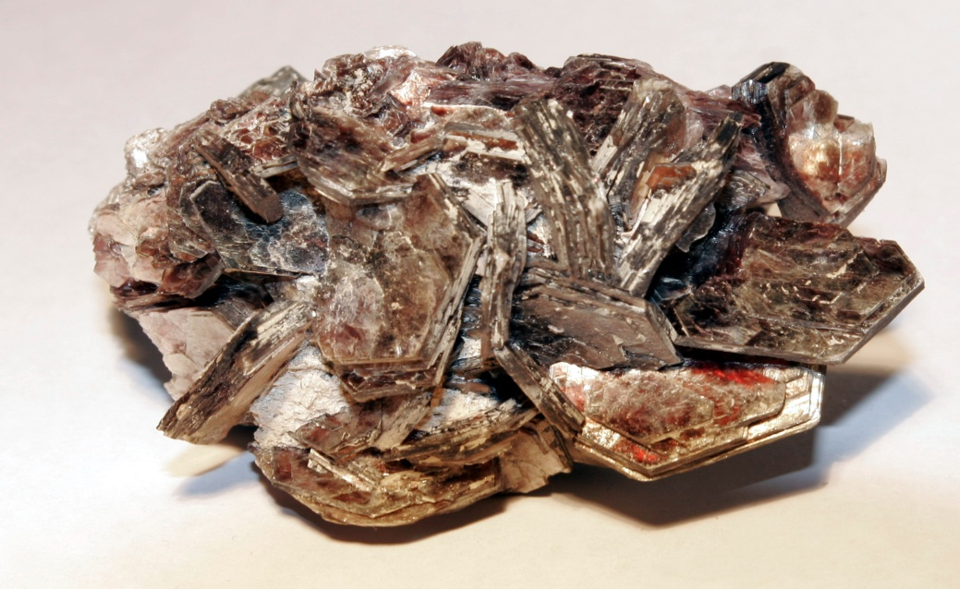
If each of these objects was a person, what would you expect their personality to be like?

Slide 2
L.O.
Explore the writer’s purpose and intentions (AF6)
S.C.
6b – Spot the overall purpose/effect
6a – Comment on key words and sentences
7 – Show understanding of the wider context

Slide 3
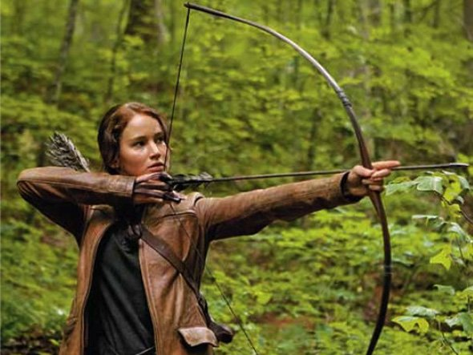
Why do you think the writer chose to name Katniss Everdeen after this plant?
What does the name suggest about her character?
Extension – Why do you think the writer chose the names Gale and Primrose for the other main characters we have met so far?

Slide 4
All the information we learn about Panem is told to us from the viewpoint of Katniss.
What are the key points we discover about the society of Panem?

Slide 5
Based on what the viewpoint character tells us (and the words she uses to describe events/ideas) what do you think Suzanne Collins’ opinion is about:
Poverty?
Freedom of Speech?
Celebrity?
The Media?
Extension Task – Can you link the society of Panem to our own society in any way? Why do you think Suzanne Collins had created these links?

Slide 6
Is Katniss a typical Dystopian Protagonist?
The Dystopian Protagonist
• often feels trapped and is struggling to escape.
• questions the existing social and political systems.
• believes or feels that something is terribly wrong with the society in which he or she lives.
• helps the audience recognizes the negative aspects of the dystopian world through his or her perspective.

Slide 7
Self Assessment
L.O.
Have you explored the writer’s purpose and intentions? (AF6)
Can you:
6b – Spot the overall purpose/effect?
6a – Comment on key words and sentences?
7 – Show understanding of the wider context?

